Slide 1
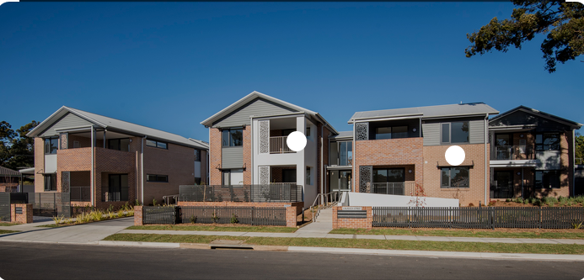
HOUSING: PRICE PREDICTION
By – Akshay Shingavi

Slide 2
Summary
Introduction
Problem Statement
What is Housing Price Prediction?
Need of Housing Price Prediction?
Exploratory Data Analysis
Correlation of features with target column
Preprocessing Steps
Model Building
Hyper Parameter Tuning
Saving the model and prediction results
Conclusion

Slide 3
Introduction
A crucial area of real estate is house price forecasting. The literature makes an effort to extract practical information from historical real estate market data. In order to find models that are helpful to home buyers and sellers, machine learning techniques are used to examine previous real estate transactions. The significant price disparity between homes in the priciest and most affordable suburbs is made clear. Additionally, tests show that the Multiple Linear Regression based on mean squared error measurement is a viable strategy.
This paper proposes a machine learning approach to forecast home prices based on information about the home (size, construction year, etc.) We will display the code used for each phase of the creation and assessment of our model, followed by its results. This will make our work easier to reproduce.

Slide 4
Problem Statement
Every individual on earth needs a home, thus the housing and real estate sectors are among those that have a significant impact on global economic growth. There are several firms operating in the industry, and the market is fairly sizable. In order to assist businesses enhance their total income and profitability, improve their marketing methods, and pay attention to shifting patterns in home sales and purchases, data science is an essential tool. For housing organizations to achieve their commercial objectives, machine learning approaches including predictive modelling, market mix modelling, and recommendation systems are applied. One of these housing companies is the source of our issue.
A US-based housing company named Surprise Housing has decided to enter the Australian market. The company uses data analytics to purchase houses at a price below their actual values and flip them at a higher price. For the same purpose, the company has collected a data set from the sale of houses in Australia.

Slide 5
What is Housing Price Prediction?
An essential driver for forecasting home prices is the correlation between housing costs and the economy. People may comprehend and be aware of the future price of a property thanks to the house price forecast.
House price prediction can help the developer determine the selling price of a house and can help the customer to arrange the right time to purchase a house. There are three factors that influence the price of a house which include physical conditions, concept and location.

Slide 6
Need of Housing Price Prediction?
Predicting house prices is crucial for maximizing real estate productivity. As before, house prices were calculated by adding together the prices for buying and selling in a certain area. In order to close the information gap and increase real estate efficiency, the house price forecast model is very crucial. With the help of this model, we could forecast prices more accurately. Check out Intelligentsia's Artificial Intelligence Certification Course if you want to learn more about it. Watch the ensuing video on the House Price Prediction Project as well.

Slide 7
Exploratory Data Analysis (EDA)
We imported two data sets: one for testing and the other for training. Our test data have 292 rows and 80 columns, whereas our train data have 1168 rows and 81 columns. We shall examine these datasets in further detail. As of right now, we can observe that while test data just contain feature columns, our train data also include a goal column (SalePrice). For the test dataset, we must forecast SalePrice.
Both category and numerical columns are present in our datasets. Since the data in our target columns is continuous, the issue is one of regression. Both data sets' column names are identical. I verified all of the Train dataset's fundamental details, including the amount of rows, columns, and D-types. Our train data set is separated into these data kinds, as can be seen. dtypes: object(43), int64(35), and float64(3) After that, I looked at the unique values of each column individually and then for all the columns together.

Slide 8
Exploratory Data Analysis (EDA)
After we have sorted our train and test null values, we will do analysis on our train dataset. We will further use below EDA techniques for our Data Analysis.
Univariate Non-graphical
Multivariate Non-graphical
Univariate graphical
Multivariate graphical

Slide 9
Data Visualization - Univariate Graphical

Slide 10
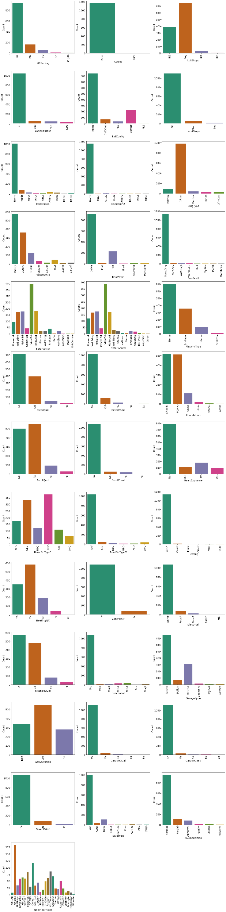


Slide 11
Observations
MSZoning - Residential low-density zoning is discovered to have the highest count for the sale's feature general zoning classification (MSZoning).
Street - The maximum number for the feature Type of road access to property may be seen under Paved Streets (Street).
LotShape - There is a maximum count for the trait "generic shape" of properties with regular shapes (LotShape).
land contour - The greatest count for a property's trait flatness is seen in a nearly level or level property (land contour).
LotConfig - The feature lot configuration has a maximum count for the inner lot specified property (LotConfig).
LandSlope - A property with a gentle slope will have the most features relative to its "slope" (land slope).
Condition1 - Norm has the highest count, it is followed by Feedr.
Condition2 - Even here Norm has the highest count, however others are very less as compare to Norm.
BldgType - Most of the buildings are 1 Farm type, were as others are too less as compared with 1 Farm type.
HouseStyle - Most of the houses are 1 Story, they are followed by 2 Story and 1.5 respectively.

Slide 12
Observations
RoofStyle - Most of them have chosed Gable RoofStyle, it is followed by Hip.
RoofMatl - Compshg have highest count, while other are vess less as compared to it.
Exterior1st - Vinylsd have highest count, it is followed by metalsd and hdfborad.
Exterior2nd - Maximum counts for the feature Exterior covering for Vinyl Siding exterior-2 covering on house.
MasVnrType - The maximum count for masonry veneer type (MasVnrType) is zero.
ExterQual - For Typical/Average (TA), the outside material's quality has the highest weight, while features evaluates this factor has the lowest weight.
ExterCond - The external material's or average (TA) state has the highest feature count. the material on the outside is evaluated for its current state.
Foundation - For foundations made of cinder blocks and poured concrete, the count is at its highest (Foundation).
BsmtQual - Number of features is significant for good and mediocre quality basement heights. considers the basement's height.

Slide 13

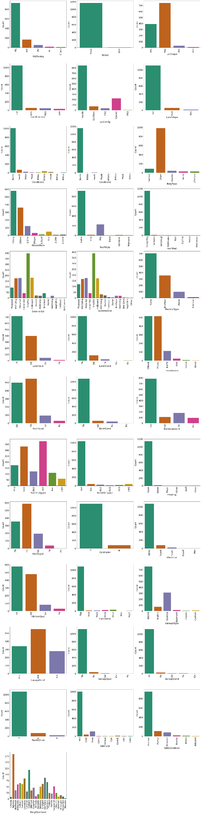

Slide 14
Observations
BsmtCond - The count is high for the trait for Typical/Average(TA) general condition of the basement. evaluates the basement's overall condition.
BsmtExposure - The feature count for No Exposure garden level walls is maximum. refers to garden level or walkout walls (BsmtExposure).
BsmtFinType1 - The count is highest for the feature Rating of Basement Finished Area for unfinished Rating of Basement Finished Area-1.
BsmtFinType2 - count for feature Rating of basement completed area (if many types) is at its highest for unfinished Rating of basement finished area-2.
Heating - Excellent Heating condition and quality For the quality and condition of the feature Heating, the count is high.
HeatingQC - Yes, the central air conditioning function has the most number of uses.
CentralAir - The count is high for the feature Electrical system for Standard Circuit Breakers & Romex Electrical system.

Slide 15
Observations
Electrical - The count is highest for the feature Kitchen quality for Typical/Average (TA) and excellent Kitchen quality.
KitchenQual - The majority of the points for "Usual Functionality" relate to "Home Functionality" (assume typical unless exceptions are.
Functional - The count is high for the feature Fireplace quality for good fireplace quality.
GarageType - For the feature Garage placement, the count is high if the garage is attached to the dwelling.
GarageFinish - The count is at its highest for the garage's showpiece interior finish, which is unfinished.
GarageQual - The count is high for Typical/Average (TA) Garage quality, while the feature Garage quality is low.
GarageCond - The count is high for the Typical/Average (TA) garage condition, but low for the highlight garage condition.
PavedDrive - The count is at its highest for the feature Paved driveway.
SaleType - The count is maximal for Warranty Deed - Conventional type of sales, and for the feature kind of sale.
SaleCondition - The count is large for normal sales conditions, and for the feature condition of sale.

Slide 16
Data Visualization – Multivariate/Bivariate Graphical

Slide 17
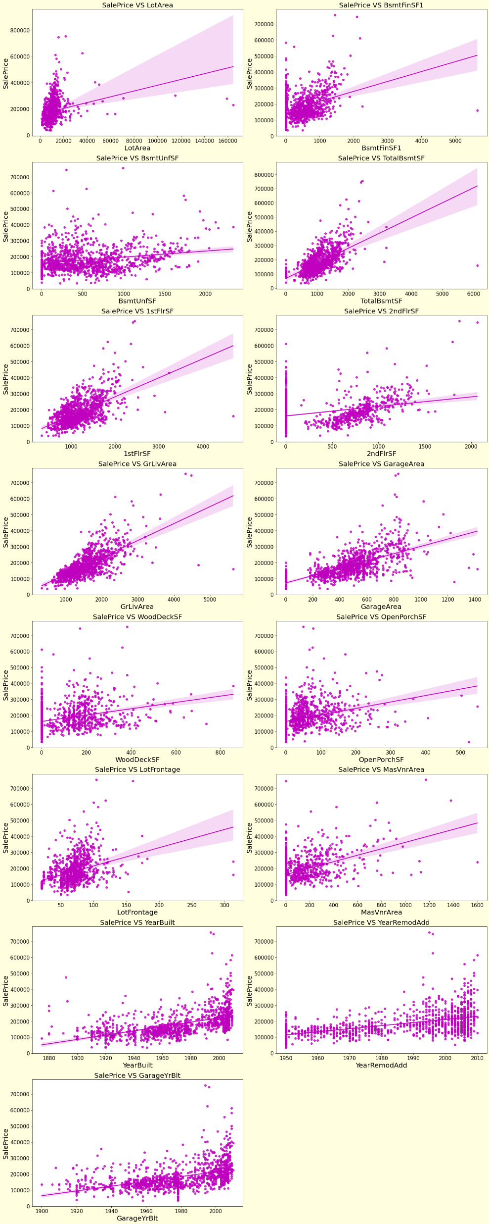

Slide 18
Observation
As the number of linear feet of street frontage on a property increases, sales are declining and the sale price is fluctuating between 0 and 3 lakhs. Sales are declining and the sale price is between 0 and 4 lakhs as lot size (lot area) increases. Sales are declining and the sale price is between 0 and 4 lakhs as the Masonry Veneer Area (MasVnrArea) grows. Sales are declining as Type 1 completed square feet (BsmtFinSF1) rise, and the sale price ranges from 0 to 4 lakhs. As unfinished basement square feet (BsmtUnfSF) increase, sales decline and the sale price ranges from 0 to 4 lakhs. There are also some anomalies. Sales are declining as total basement square feet (TotalBsmtSF) increases, and the sale price ranges from 0 to 4 lakhs. Sales are declining as First Floor square feet (FirstFlrSF) increases, and the sale price ranges from 0 to 4 lakhs. As second floor square feet (second floor SF) increases, sales rise by 500–1000 and the sale price ranges from 0–4 lakhs. As above-ground living space (GrLivArea) increases, sales decline and the sale price ranges from 0 to 4 lakhs. Sales are increasing and the sale price ranges from 0 to 4 lakhs as garage area (measured in square feet) increases. As the square footage of wood decks (WoodDeckSF) increases, sales decline and the sale price ranges from 0 to 4 lakhs. As open porch square footage (OpenPorchSF) increases, sales decline and the sale price ranges from 0 to 4 lakhs. Sales are declining as Year Since Built increases, and the sale price is high for recently constructed buildings, ranging from 0 to 4 lakhs. Sales are declining and the sale price is between 1-4 lakhs as of the Year SinceRemodAdded (same as construction date if no remodelling or additions) date, which is increasing. Sales are declining and the sale price is between 0 and 4 lakhs as garage age (the year it was built) increases.

Slide 19
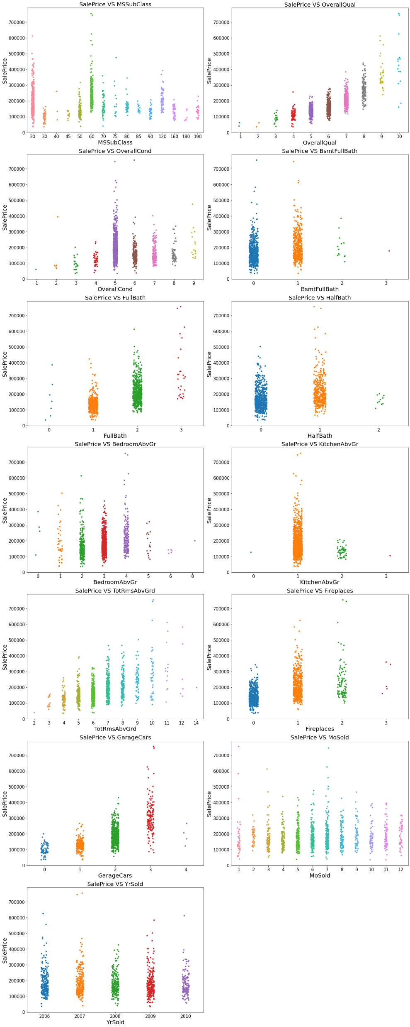


Slide 20
Observation
The sales are strong and the sale price is high for dwellings that are 1-STORY 1946 & NEWER ALL STYLES (20) and 2-STORY 1946 & NEWER (60) in the MSSuubClass. As rates rise, sales and the sale price both rise linearly along with the overall quality of the home's construction (OverallQual). The sales are strong and the sale price is similarly high for homes in 5(Average) overall condition. Both sales and selling prices are high for basement full bathrooms with a count of 0 and 1, or BsmtFullBath. The sale price and sales volume for 0 Basement half bathrooms (BsmtHalfBath) are both high. Both sales and selling prices are high for full bathrooms above grade (1 and 2). Sales as well as SalePrice are high for homes with 0 and 1 Half bathrooms above grade (HalfBath).
The sales in addition to SalePrice are high for 2, 3, and 4 bedroom above grade (not Included in basement bedrooms) (BedroomAbvGr). For one Kitchen Above Grade, both sales and sale prices are high. Both the sales volume and the sale price are high for properties with 4 to 9 total rooms over grade (excluding bathrooms).
Sales in addition to SalePrice are high for 0 and one fireplaces (Fireplaces). Sales are high for garages with a car capacity of 1 and 2, and the sale price is high for garages with a car capacity of 3. For Month Sold (MoSold), the sales are good with SalePrice from April to August. The salePrice & sales are same for all Years Sold.

Slide 21
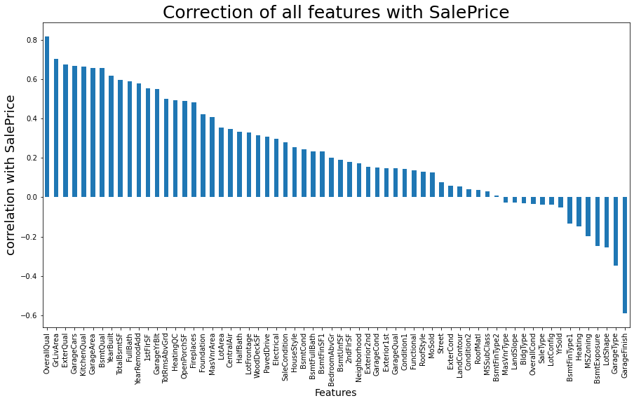
According to the bar plot, the column OverallQual is most positively correlated with the goal column and GarageFinish is most negatively correlated with target column.

Slide 22
Pre-processing Steps
I have used imputation techniques to handle null values. To increase data normalcy and linearity, I have carried out feature engineering processes such feature extraction and feature selection. Boxplots were used to find outliers, and the percentile approach was used to eliminate them.
Distribution plots were used to identify skewness, and the power transformation approach was used to eliminate it (yeo-johnson method) data using the Ordinal Encoder.
checked the correlation between the dependent and independent variables using Pearson's correlation coefficient. Heatmap and bar plot were used to show the association.
To scale the data, I used the Standard Scalarization technique the multicollinearity problem was solved by determining VIF values.

Slide 23
Pre-processing Steps
To create machine learning models, separate training and testing. The construction of models will be demonstrated in the following phases.
First, the issue description specifies that it is a regression type problem, and we will develop our models and forecast the sale price of the home using regressor techniques.
Second, the analysis and visualization portions showed that several characteristics had linear relationships with labels. So, I believed that these characteristics would be useful in creating models and predicting the sale price of the home. Additionally, these characteristics play a crucial role since they might influence a potential buyer's decision to buy a home based on factors like the neighborhood, property quality, and surroundings.
As a result, I advise that individuals evaluate the characteristics that were seen as being most crucial, including

Slide 24
Model Building
Since the objective variable in this problem, SalePrice, is continuous in nature, I may infer that it is a regression-type problem, and to estimate the selling price of the property, I have employed the following regression techniques.
Regression Algorithms
1. RandomForestRegressor
2. Bagging Regressor
3. GradientBoostingRegressor
4. DecisionTreeRegressor

Slide 25
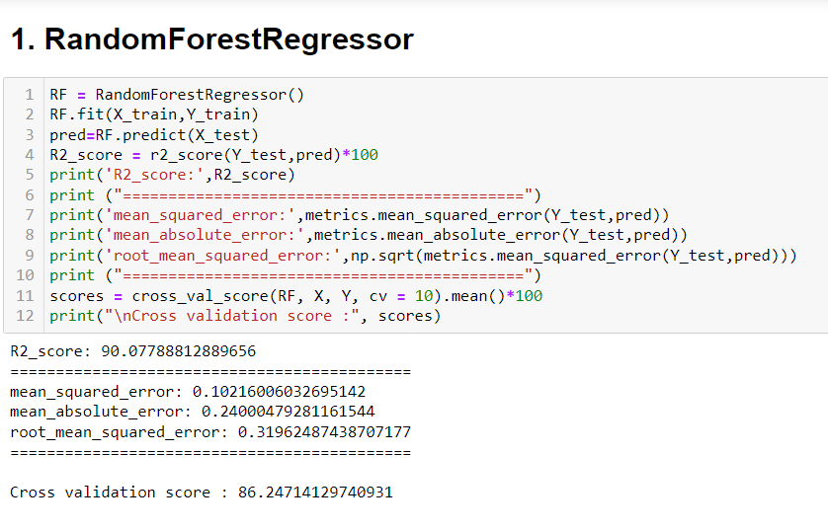
Random Forest Regressor
Created a Random Forest Regressor model and got accuracy of approximately 86.24%. (Before Cross Validation R2 Score = 90.07%)

Slide 26
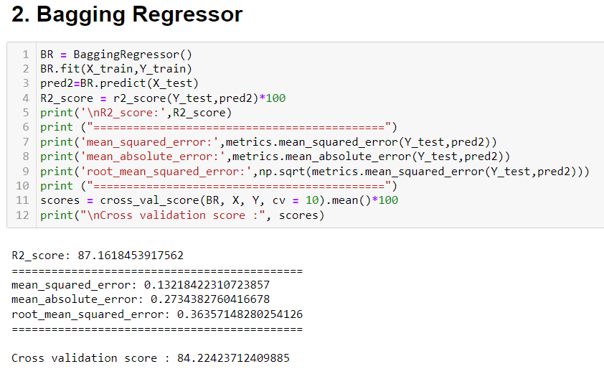
Bagging Regressor
Created a Bagging Regressor model and got accuracy of approximately 84.22%. (Before Cross Validation R2 Score = 87.16%)

Slide 27
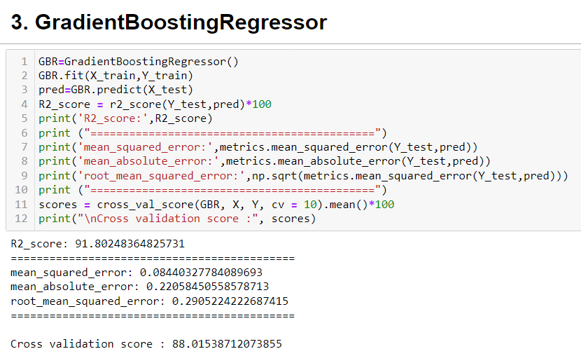
Gradient Boosting Regressor
Created a Gradient Boosting Regressor model and got accuracy of approximately 91.80%. (Before Cross Validation R2 Score = 88.01%)

Slide 28
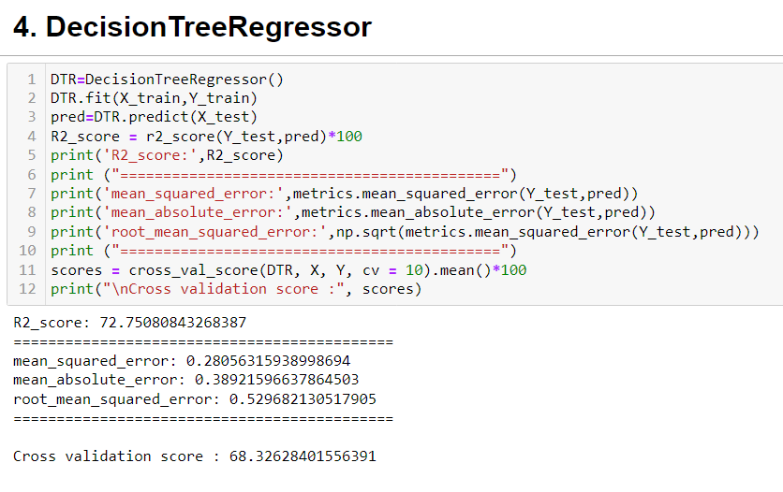
Decision Tree Regressor
Created a Decision Tree Regressor model and got accuracy of approximately 68.32%. (Before Cross Validation R2 Score = 72.75%)

Slide 29
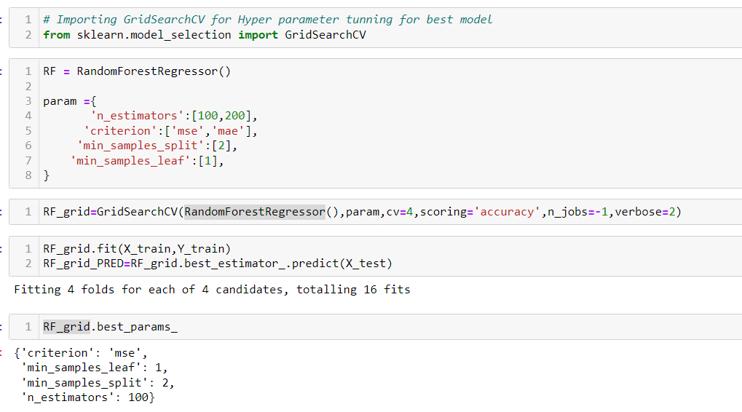
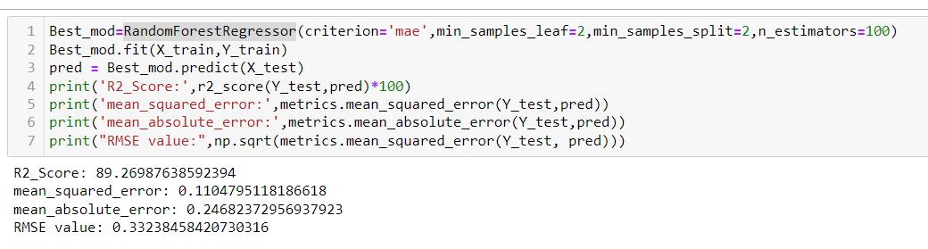
Hyper Parameter Tuning

Slide 30
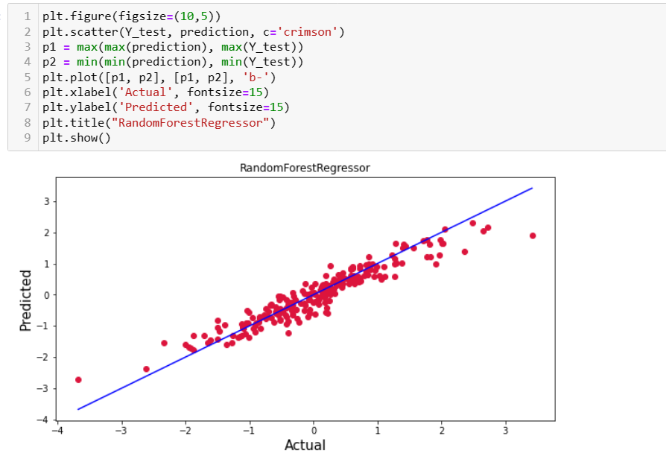
Hyper Parameter Tuning
I selected all of the Random Forest Regressor settings, and after fine-tuning the model with the optimal parameters, I increased model accuracy from 86% to 89%. Additionally, mse and rmse readings have decreased, indicating that error has decreased.

Slide 31
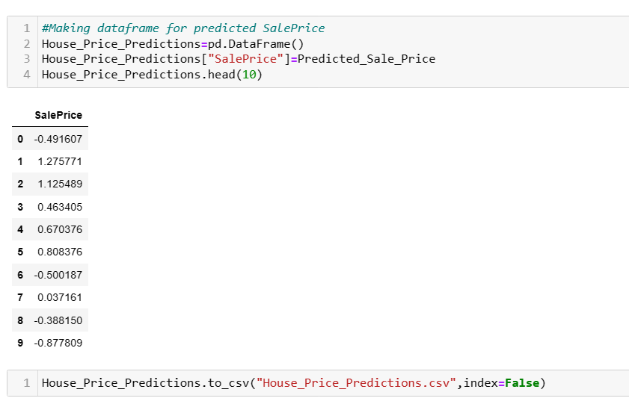
Saving Model Predictions
I have saved my model and the image of the left is showing prediction form test data.

Slide 32
Conclusion
To anticipate the price of homes, we applied machine learning techniques in our project report.
The step-by-step process for analyzing the dataset and determining the connection between the features has been described. As a result, we may choose traits that are independent and not associated with one another.
These feature sets were then used as input for five algorithms, which produced a csv file with forecasted home prices.
As a result, we used several performance measures to determine each model's performance and then compared them using these criteria. Then, we additionally stored the dataframe for the test dataset's anticipated prices.

Slide 33
Conclusion
In conclusion, machine learning is still being applied in property research at a very early level.
We believe our work has made some methodological and empirical advances in the field of property evaluation and has offered an alternate way for estimating home values.
Future studies may focus on examining different property kinds aside from housing developments or combining more property transaction data from a bigger geographical area with more attributes.

Slide 34
Thank You

